Slide 1
OBJECTIVES
Loops (While & For ).
Set and Shift : Manipulating and Positional Parameters.
The Sample Database.
Head.
Tail.
Cut.
Paste.
Sort.
File Systems and Inodes.
Hard links.
Symbolic Links. (Soft Links)
The Directory.
Umask.
Modification and Access Times.

Slide 2
While Loops
A while Loop is a control flow statement that allows code to be executed repeatedly based on a given condition.
Syntax :
while condition is true
do
commands
done
The commands that are enclosed by do and done are executed repeatedly as long as condition remains true.

Slide 3
Example
#!/bin/sh
#Shell script to illustrate while loop --- while.sh
answer=y;
while [“$answer”=“y”]
Do
echo “Enter Branch Code and Name: \c”
read code name
echo “$code|$name”>>newlist
echo “Enter more (y/n)?\c”
read anymore
case $anymore in
y*|Y*) answer=y;;
n*|N*) answer=n;;
*)answer=n;;
esac
done

Slide 4
Execution & Ouput
$chmod 777 while.sh
$sh while.sh
Enter Branch Code and Name : CS Computer [enter]
Enter more (y/n)? Y [enter]
Enter Branch Code and Name : EC Electronics [enter]
Enter more (y/n)? n [enter]
$cat newlist
CS|Computer
EC|Electronics

Slide 5
The shell also offers an until statement which operates with a reverse logic used in while loop.
With until, the loop body is executed as long as the condition remains false.
Syntax:
until [ condition ]
do
block-of-statements
done

Slide 6
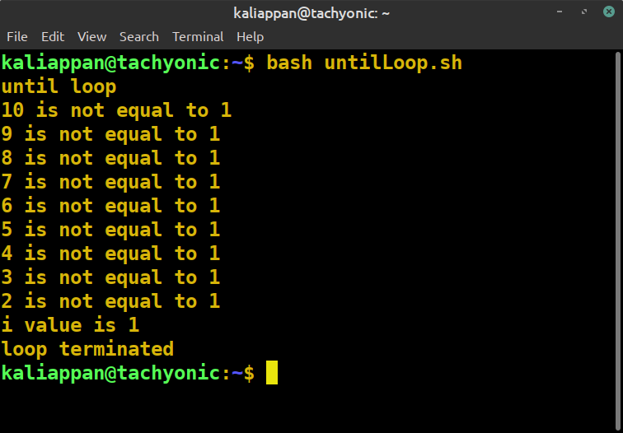
Example
#!/bin/bash
echo "until loop"
i=10 until [ $i == 1 ]
do
echo "$i is not equal to 1";
i=$((i-1))
done
echo "i value is $i"
echo "loop terminated"

Slide 7
For Loop
The shell’s for loop differs in structure from the ones used in the other programming language.
Unlike while and until, for doesn’t test a condition, but uses a list instead.
Syntax:
for variable in list
do
commands
done
The loop body also uses the keywords do and done, but the additional parameters here are variables and list.
Each whitspace-separated word in list is assigned to variable in turn, and commands are executed until list is exhausted.

Slide 8
Example
Execution and Output
$chmod 777 forloop.sh
$sh forloop.sh
Chap1 copied to chap1.bak
Chap2 copied to chap2.bak
Chap3 copied to chap3.bak
Chap4 copied to chap4.bak
#!/bin/sh
for file in chap1 chap2 chap3 chap4
do
cp $file${file}.bak
echo “$file copied to $file.bak”
done

Slide 9
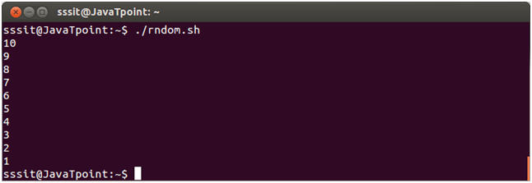
Example
For loop can also be used in another way that is similar to other programming language.
Syntax :
for ((cond1;cond2;cond3))
do
commands
done
condition1 indicates initialization, cond2 indicates condition and cond3 indicates updation.
Sample program
for ((i=10;i>=1;i--))
do
echo “$i”
done

Slide 10
Set and Shift
Set: Set the positional parameters
set assigns its arguments to the positional parameters $1, $2 and so on.
This feature is especially useful for picking up individual fields from the output of a program.
Example: $ set `date` #Output of date command assigned to positional parameters $1, $2 & so on. $ echo $* Sun Jan 13 15:40:13 IST 2013 $ echo “The date today is $2 $3 $6” The date today is Jan 13 2013

Slide 11
Shift: Shifting Arguments Left
Shift transfers the contents of a positional parameters to its immediate lower numbered one.
This is done as many times as the statement is called.
Example: $ set `date` $ echo $* Sun Jan 13 15:40:13 IST 2013 $ echo $1 $2 $3 Sun Jan 13 $ shift #Shifts 1 place Jan 13 15:40:13 $ echo $1 $2 $3 $ shift 2 #Shifts 2 places $ echo $1 $2 $3 15:40:13 IST 2013

Slide 12
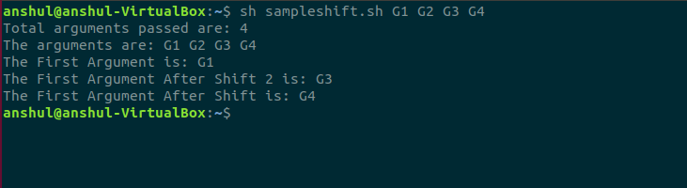
Example
#!/bin/bash
# total number of command-line arguments
echo "Total arguments passed are: $#"
# $* is used to show the command line arguments echo "The arguments are: $*"
echo "The First Argument is: $1"
shift 2
echo "The First Argument After Shift 2 is: $1"
shift
echo "The First Argument After Shift is: $1"

Slide 13
13. THE SAMPLE DATABASE
The following emp.lst is an reference database file to understand features of several UNIX
commands including filters, text editors and shell programming. It's a good idea to understand the
organization of emp.lst database file.
$ cat emp.lst
2233|a. k. shukla |g. m. |sales |12/12/52|6000
9876|jai sharma |director |production |12/03/50|7000
5678|sumit chakrobarty |d. g. m. |marketing |19/04/43|6000
2365|barun sengupta |director |personnel |11/05/47|7800
5423|n. k. gupta |chairman |admin |30/08/56|5400
1006|chanchal singhvi |director |sales |03/09/38|6700
6213|karuna ganguly |g. m. |accounts |05/06/62|6300
1265|s. n. dasgupta |manager |sales |12/09/63|5600
4290|jayant choudhury |executive |production |07/09/50|6000
2476|anil aggarwal |manager |sales |01/05/59|5000
6521|lalit chowdury |director |marketing |26/09/45|8200
3212|shyam saksena |d. g. m. |accounts |12/12/55|6000
3564|sudhir Agarwal |executive |personnel |06/07/47|7500
2345|j. b. saxena |g. m. |marketing |12/03/45|8000
0110|v. k. agrawal |g. m. |marketing |31/12/40|9000

Slide 14
This is a text file designed in fixed format and containing a personnel database.
There are 15 lines in the file, where each line has six fields separated from one another by the
delimiter |.
The details of an employee are stored in one line.
A person is identified by emp_id, name, designation, department, date of birth and salary.
14. head: DISPLAYING THE BEGINNING OF A FILE
The head command, as the name implies, displays the top of the file.
When used without an option, it displays the first ten lines of the file.
Head: Syntax
Head [option]… [file]…
Head –n: prints the first “num” lines instead of first 10 lines. Num is mandatory to be specified in command otherwise it displays an error.
//
head –n num {filename}

Slide 15
Example:
$ head -n 3 emp.lst #Displays first 3 lines from emp.lst
2233|a. k. shukla |g. m. |sales |12/12/52|6000
9876|jai sharma |director |production |12/03/50|7000
5678|sumit chakrobarty |d. g. m. |marketing |19/04/43|6000
Head –c
Prints the num byte from the file specified
Example: head –c 3 emp.lst
head –v
Data from the specified file is always preceeded by its file name

Slide 16
15. tail: DISPLAYING THE END OF A FILE
Complementing its head counterpart, the tail command displays the end of the file.
Like an head, it displays last ten lines of file by default.
tail:syntax tail [option]…[file]…
Example:
$ tail -n 3 emp.lst #Displays last 3 lines from emp.lst
3564|sudhir Agarwal |executive |personnel |06/07/47|7500
2345|j. b. saxena |g. m. |marketing |12/03/45|8000
0110|v. k. agrawal |g. m. |marketing |31/12/40|9000

Slide 17
16. cut: SLITTING A FILE VERTICALLY
Cutting Columns ( -c )
To extract specific columns, you need to follow the -c option with a list of column numbers,
delimited by comma.
Cutting out the sections from each line of files and writing the result to standard output. It can be used to cut the lines by byte position, character and field.
cut: syntax cut OPTION…[FILE]
Examples:
$ head -n 5 emp.lst | tee shortlist #tee saves output in file shortlist & also display it on the
terminal
2233|a. k. shukla |g. m. |sales |12/12/52|6000
9876|jai sharma |director |production |12/03/50|7000
5678|sumit chakrobarty |d. g. m. |marketing |19/04/43|6000
2365|barun sengupta |director |personnel |11/05/47|7800
5423|n. k. gupta |chairman |admin |30/08/56|5400
$ cut -d \| -f 2,3 shortlist
a. k. shukla g.m.
jai sharma director
sumit chakrobartyd. g. m.
barun sengupta director
n. k. gupta chairman

Slide 18
Cutting Fields (-f)
The -c option is useful for fixed-length line. Most UNIX files don't contain fixed-length lines.
To extract useful data from these files you need to cut fields rather than columns.
The cut used tab as default field delimiter, but can also work with different delimiter.
The two options need to be used here:
-d for the filed delimiter
-f for the field list.
Syntax: $cut –d “delimiter” –f (field number) file
The below example shows how to cut the second and third fields from file shortlist
example:
$ cut -d \| -f 2,3 shortlist
a. k. shukla |g. m.
jai sharma |director
sumit chakrobarty |d. g. m.
barun sengupta |director
n. k. gupta |chairman

Slide 19
17. paste: PASTING FILES
What you cut with cut can be pasted back with the paste command – but vertically rather than
horizontally.
You can view two files side by side by pasting them.
Syntax: paste [OPTION]…[FILE]…
Without any option paste merges the files in parallel. The paste command writes corresponding lines from the files with tab as delimeter on the terminal
Example:
$ cut -d \| -f 2,3 shortlist | tee cutlist1
a. k. shukla |g. m.
jai sharma |director
sumit chakrobarty |d. g. m.
barun sengupta |director
n. k. gupta |chairman
$ cut -d \| -f 5,6 shortlist | tee cutlist2
12/12/52|6000
12/03/50|7000
19/04/43|6000
11/05/47|7800
30/08/56|5400
$ paste cutlist1 cutlist2 #Combines two files vertically
a. k. shukla |g. m. 12/12/52|6000
jai sharma |director 12/03/50|7000
sumit chakrobarty |d. g. m. 19/04/43|6000
barun sengupta |director 11/05/47|7800
n. k. gupta |chairman 30/08/56|5400

Slide 20
18. sort: ORDERING A FILE
Sorting is the ordering of data in ascending or descending sequence.
The sort command orders a file.
Like cut, it identifies fields and it can sort on specified fields.
By default, sort reorders lines in ASCII collating sequence – whitespace first, then numerals,
uppercase letters and finally lowercase letters.
Example:
$ sort shortlist
2233|a. k. shukla |g. m. |sales |12/12/52|6000
2365|barun sengupta |director |personnel |11/05/47|7800
5423|n. k. gupta |chairman |admin |30/08/56|5400
5678|sumit chakrobarty |d. g. m. |marketing |19/04/43|6000
9876|jai sharma |director |production |12/03/50|7000
Sort Options | Option Description
-tchar -k n -k m, n -u -n -f -c | Uses delimiter char to identify fields Sorts on nth filed Starts sort on nth column of mth field Removes repeated lines Sorts numerically Case-insensitive sort Checks if file is sorted

Slide 21
FILE SYSTEMS AND INODES
An inode is a data structure in UNIX operating systems that contains important information pertaining to files within a file system
The hard disk is split into distinct partitions
Every file system has a directory structure headed by root
When the system is up, we see only a single file system with a single root directory
Every file is associated with a table and this table is called the inode

Slide 22
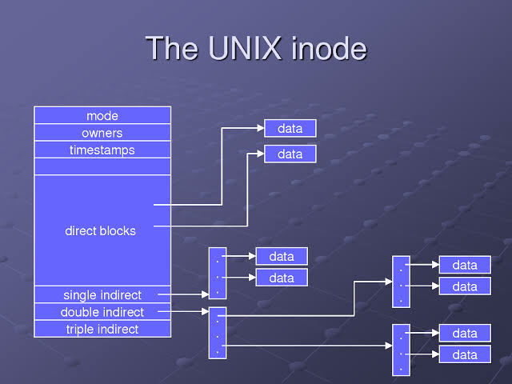
The inode contains the following attributes of a file:
file type – regular, directory, device etc
file permissions – the nine permissions and three more
Number of links – the number of aliases the file has
The UID of the owner
The GID of the group owner
File size in bytes
Date and time of last modification
Date and time of last access
Date and time of last change of the inode
An array of pointers that keep track of all disk blocks used by the file

Slide 23
Neither the name of the file nor the inode number is stored in the inode.
Example:
$ ls -il test.c
13109062 -rwxrwxrwx 1 chandrakant chandrakant 639 Dec 10 13:18 test.c
The file test.c has the inode number 13109062. This inode number is unique in this file system.
Unique Number
Position of the inode
Simple Arithmetic
ls command is used with inode

Slide 24
HARD LINKS
A hard link is essentially a label or name assigned to a file
Example:
$ ls -li backup.sh restore.sh
478274 -rwxrwxrwx 2 chandrakant chandrakant 163 Dec 10 13:18 backup.sh
478274 -rwxrwxrwx 2 chandrakant chandrakant 163 Dec 10 13:18 restore.sh
Creating hard links:
Example:
$ ln emp.lst employee #Ensure employee must not exist
$ ls -li emp.lst employee
13110850 -rw-rw-r-- 2 chandrakant chandrakant 811 Jan 21 15:41 employee
13110850 -rw-rw-r-- 2 chandrakant chandrakant 811 Jan 21 15:41 emp.lst

Slide 25
Where to use Hard Links?
Whenever you reorganized your directory structure and moved file from one place to another, create and use hard link to refer the moved file with same old pathname in all the programs in that you are previously using the same file, without modifying the program.
Hard links provides some protection against accidental deletion, especially when they exist in different directories.
Because of links, we don't need to maintain two programs as two separate disk files if there is very little difference between them.

Slide 26
SYMBOLIC LINKS
Until now, we have divided files into three categories – ordinary, directory and device.
The symbolic link is the fourth file type considered in this text.
Unlike the hard link, a symbolic link doesn't have the file's contents, but simply provides the pathname of the file that actually has the contents.
A symbolic link is also known as soft link.
Symbolic links can also be used with relative pathnames.

Slide 27
The hard link have two limitations:
You can't have two linked filenames in two file systems
You can't link a directory even within the same file system.
How to create soft link?
The ln command with -s option creates symbolic links.
Example:
$ ln -s emp.lst employee #Ensure employee must not exist
$ ls -li emp.lst employee
13110850 -rw-rw-r-- 1 chandrakant chandrakant 80 Jan 21 15:41 emp.lst
13112164 lrwxrwxrwx 1 chandrakant chandrakant 7 Jan 26 19:34 employee -> emp.lst

Slide 28
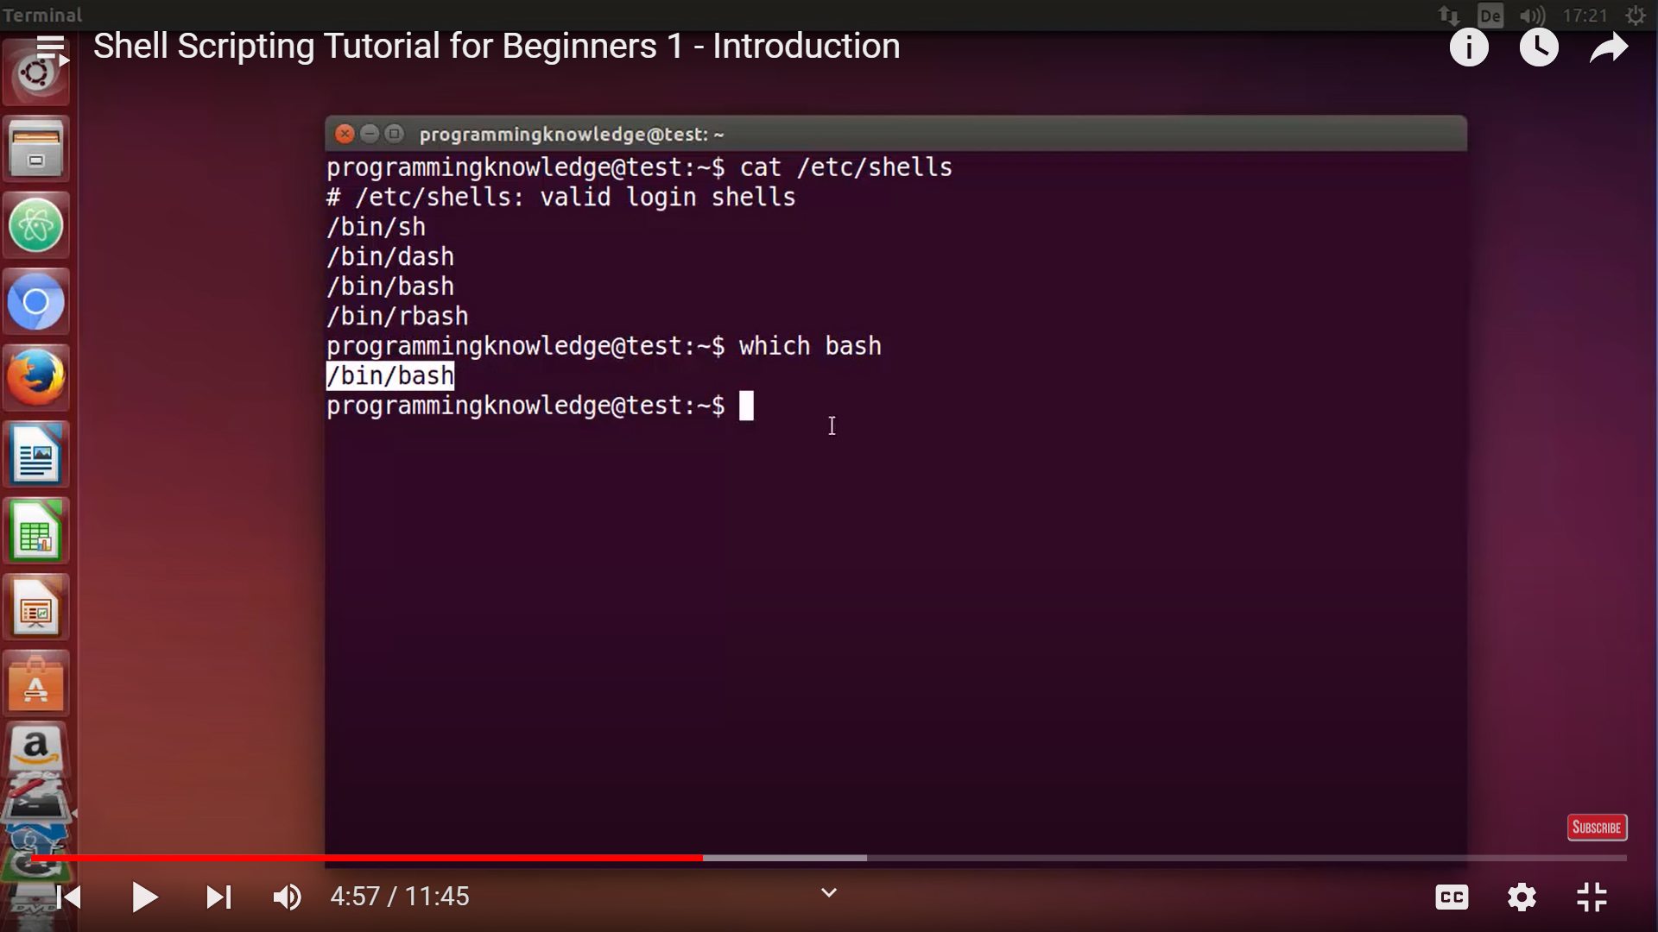

Slide 29
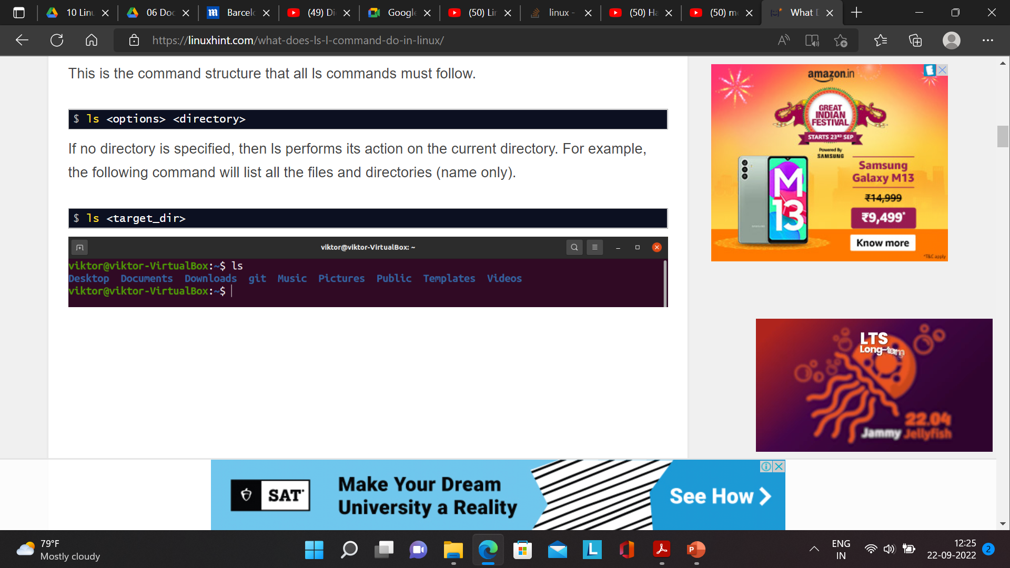
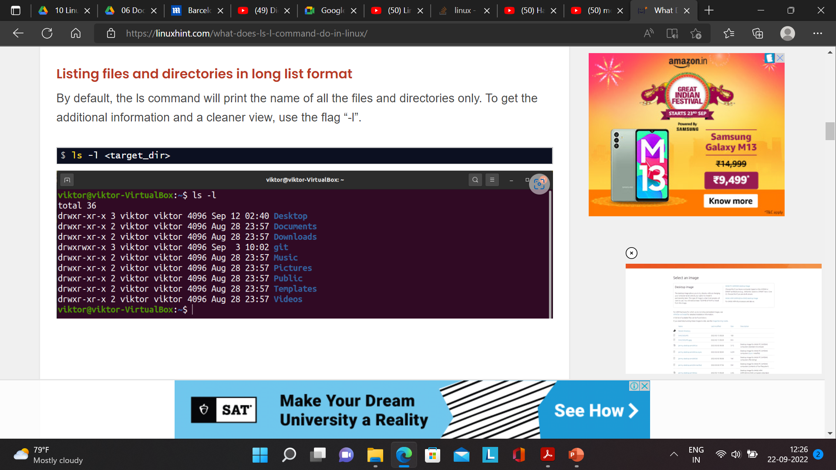
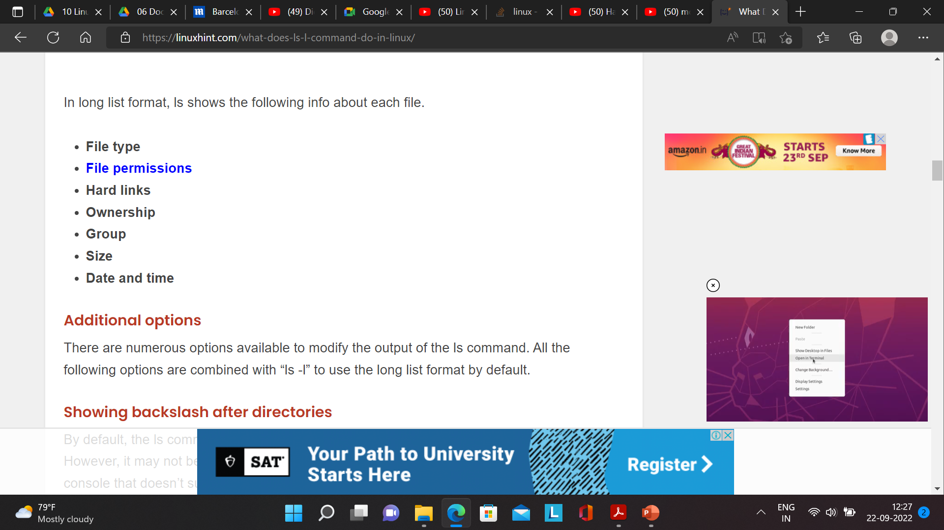

Slide 30
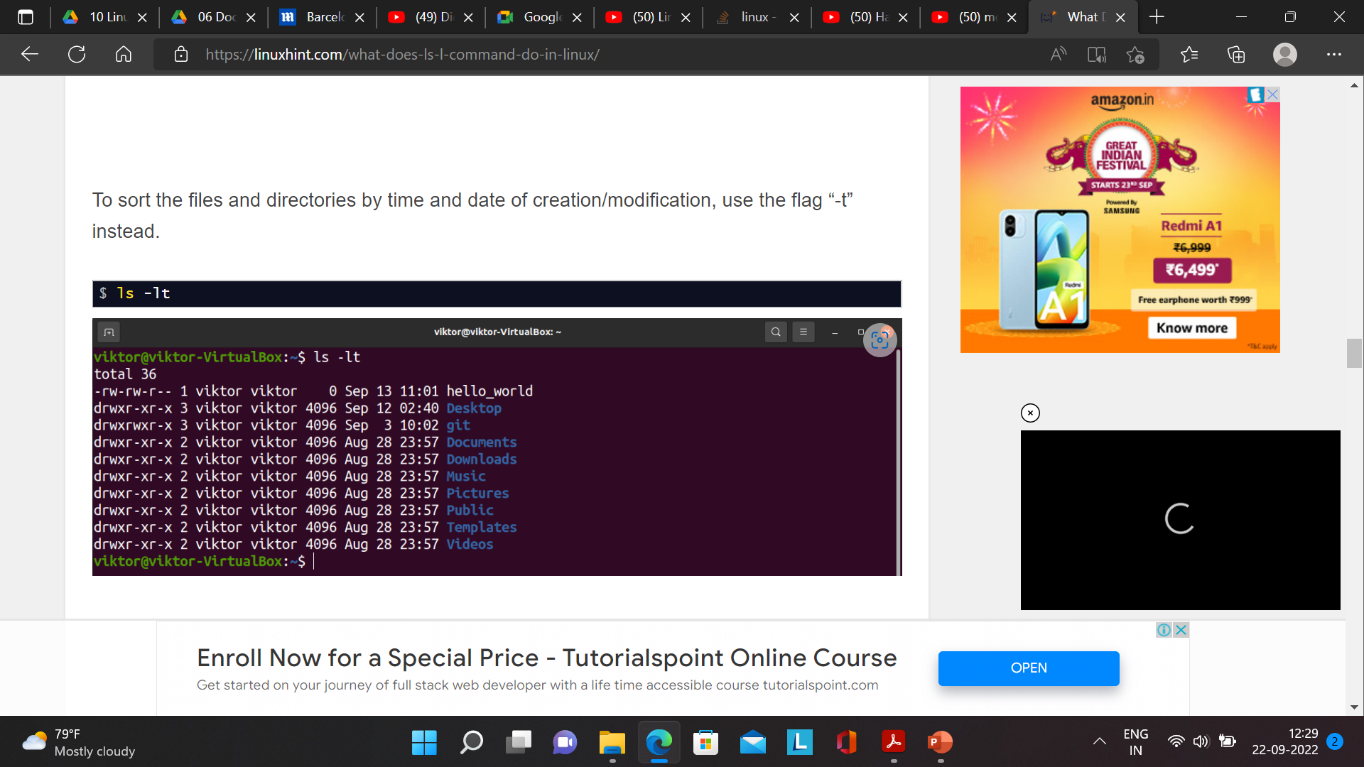

Slide 31
Access and Modification times
Time of last access shown : ls –lu
Time of last inode modification : ls –lc
When you write to a file, time of last modification is updated in the file's inode.
A directory can be modified by changing its entries – by creating, removing and renaming files in
the directory.
Even though ls -l and ls -u shows the last modification and access time, respectively, the sort
order remains standard, i.e. ASCII.
However, when you add the -t option to -l or -lu, the files are actually displayed in order of the
respective time stamps:
ls -lt Displays file listing in order of their modification time
ls -lut Displays file listing in order of their access time.

Slide 32
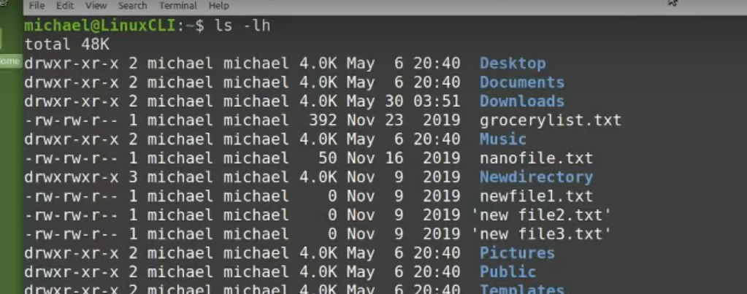
Directories, read write and execute permissions

Slide 33
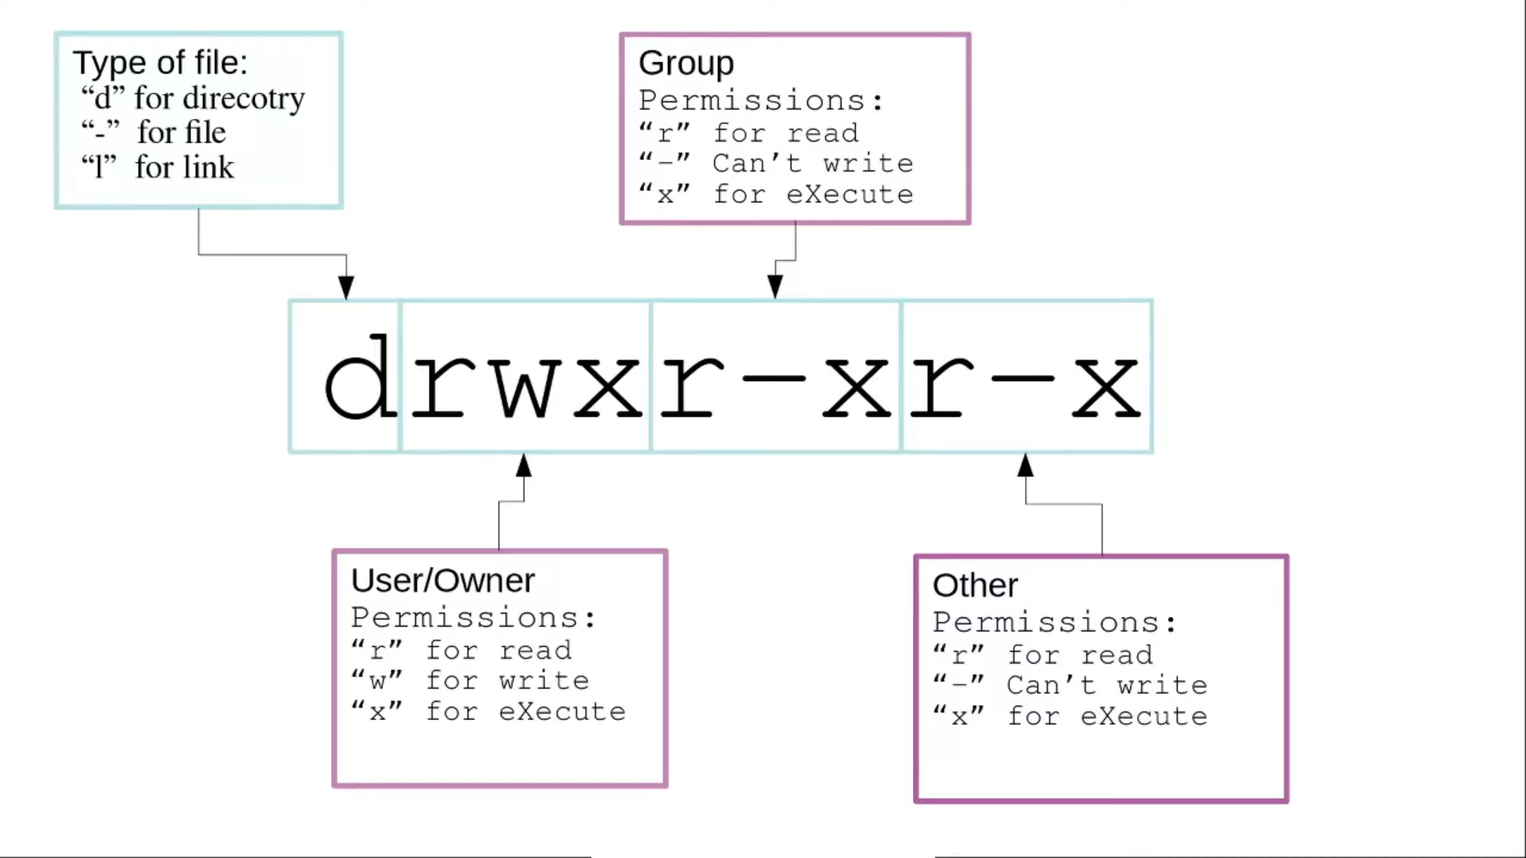

Slide 34
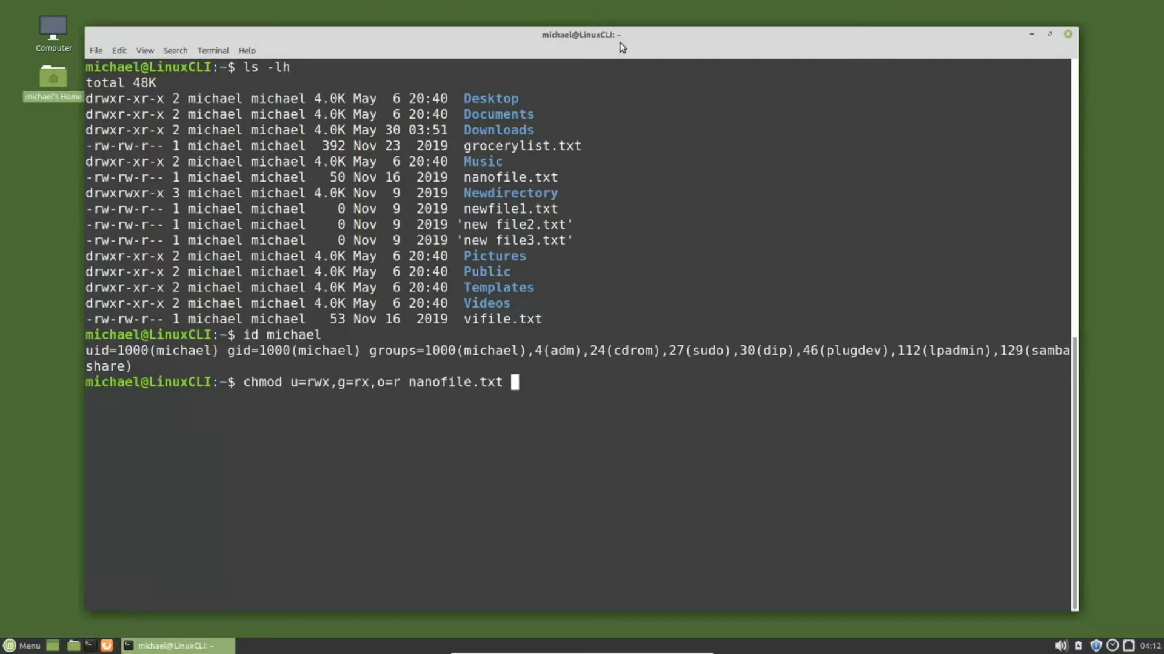

Slide 35
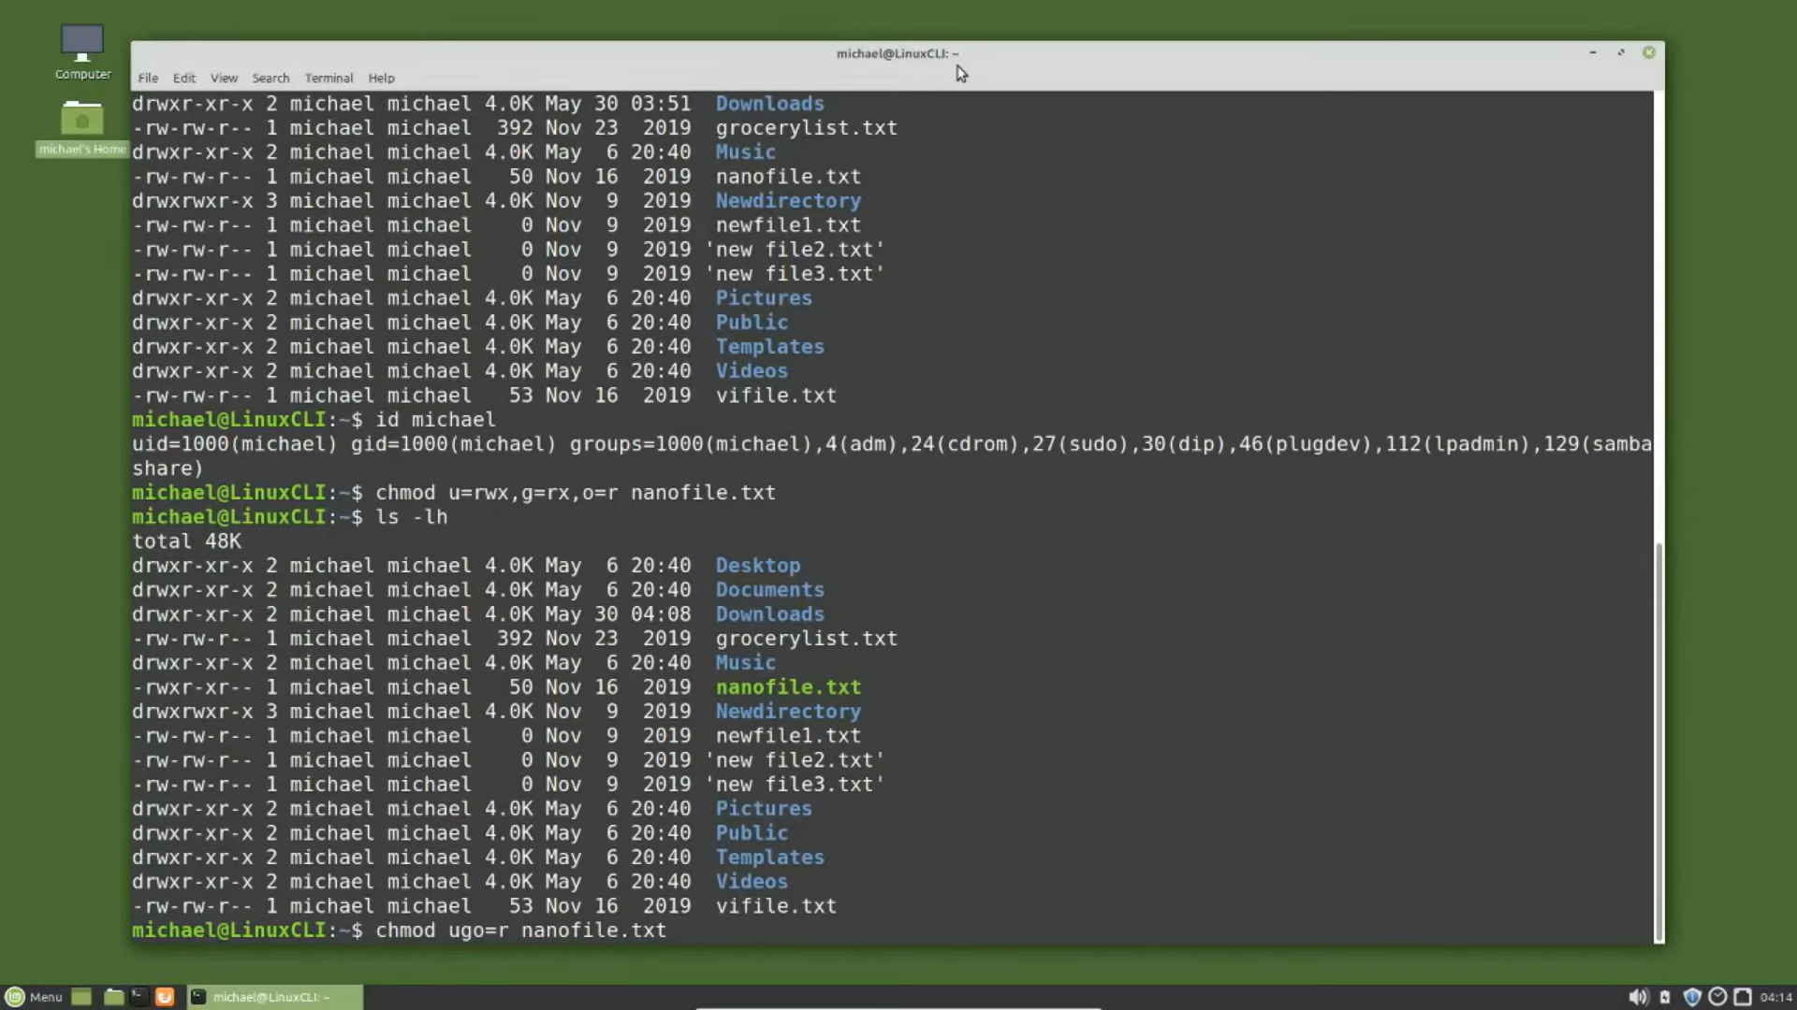
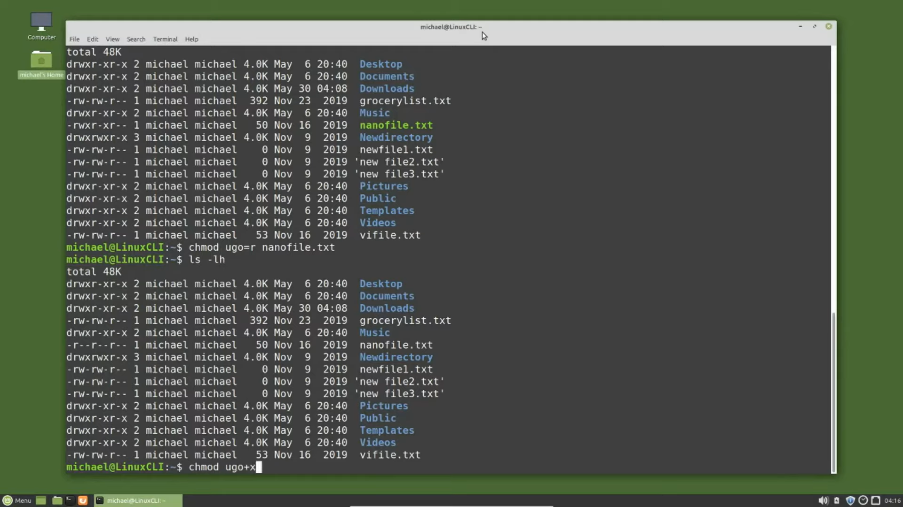
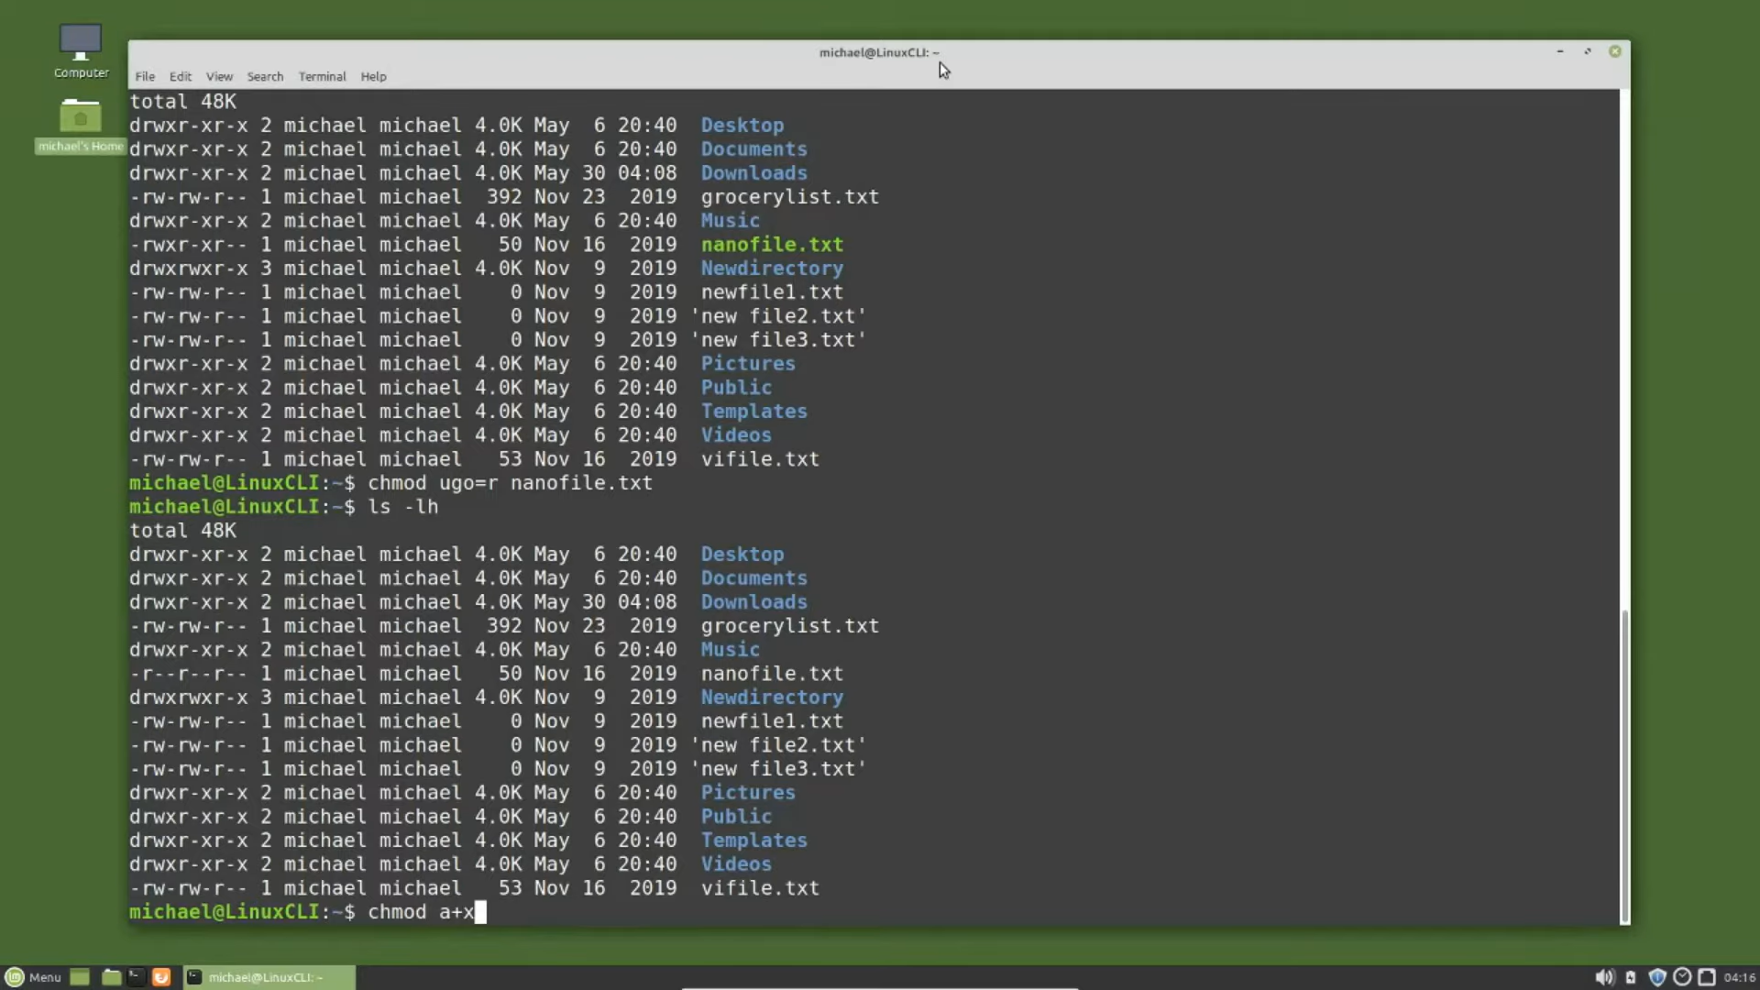
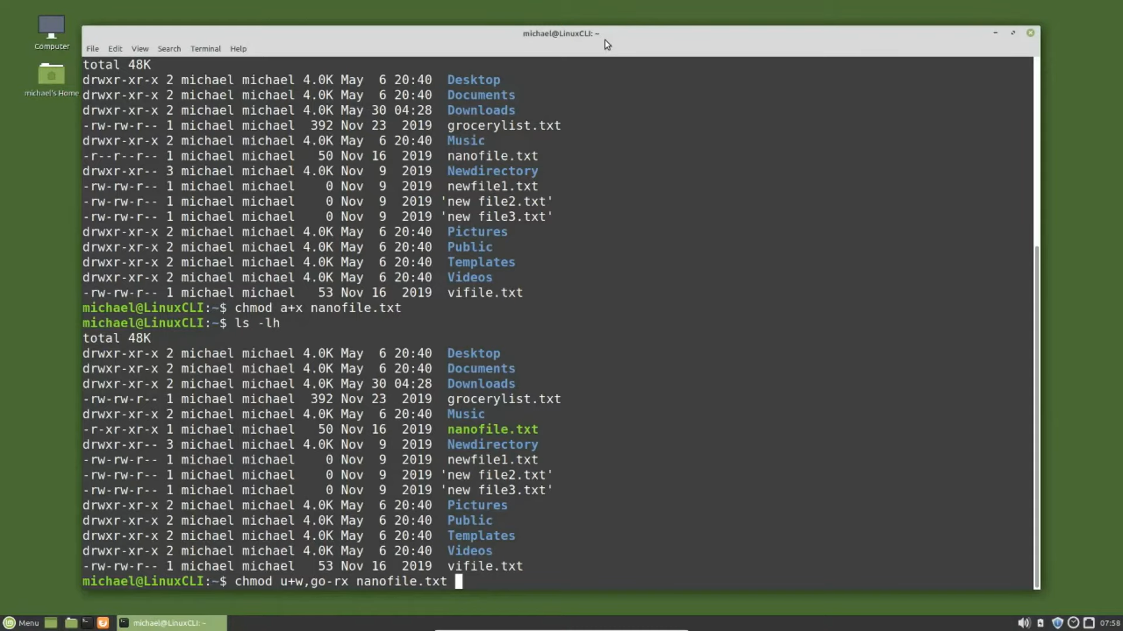

Slide 36
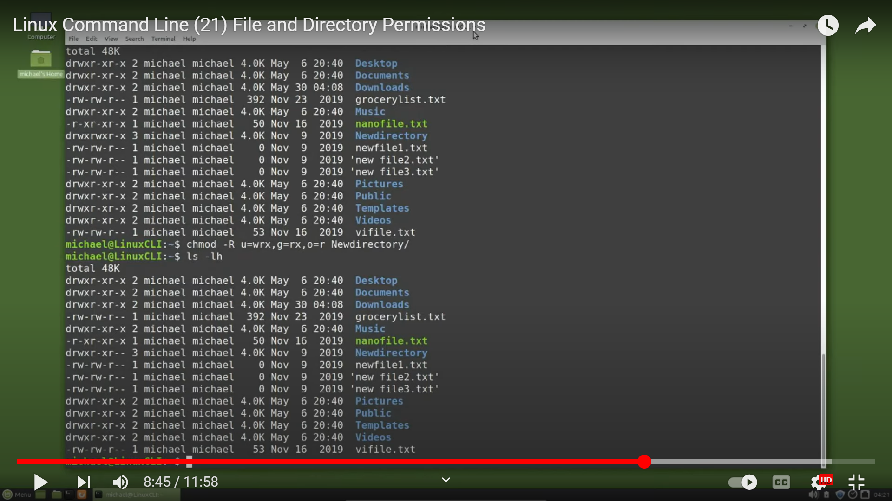

Slide 37
Execute Permission
Executing a directory just doesn't make any sense, so what does its execute privilege
mean?
It only means that a user can “pass through” the directory in searching for subdirectories.
When you use a pathname with any command – cat /home/chandrakant/sample/emp.lst
you need to have execute permission for each of the directories involved in the complete
pathname.
The directory home contains entry for chandrakant, and the directory chandrakant
contains entry for sample, and so forth.
If a single directory in this pathname doesn't have execute permission, then it can't be
searched for the name of the next directory.
That's why the execute privilege of a directory is often referred to as the search
permission.

Slide 38
UMASK
umask (user file-creation mode) is a Linux command that lets you set up default permissions for newly created files and folders.
A user-defined permissions ‘mask’.
A user can choose how to restrict permissions by using a permissions mask.
A permission mask interacts with the default system permissions and changes them.
The umask command is used to apply this mask

Slide 39
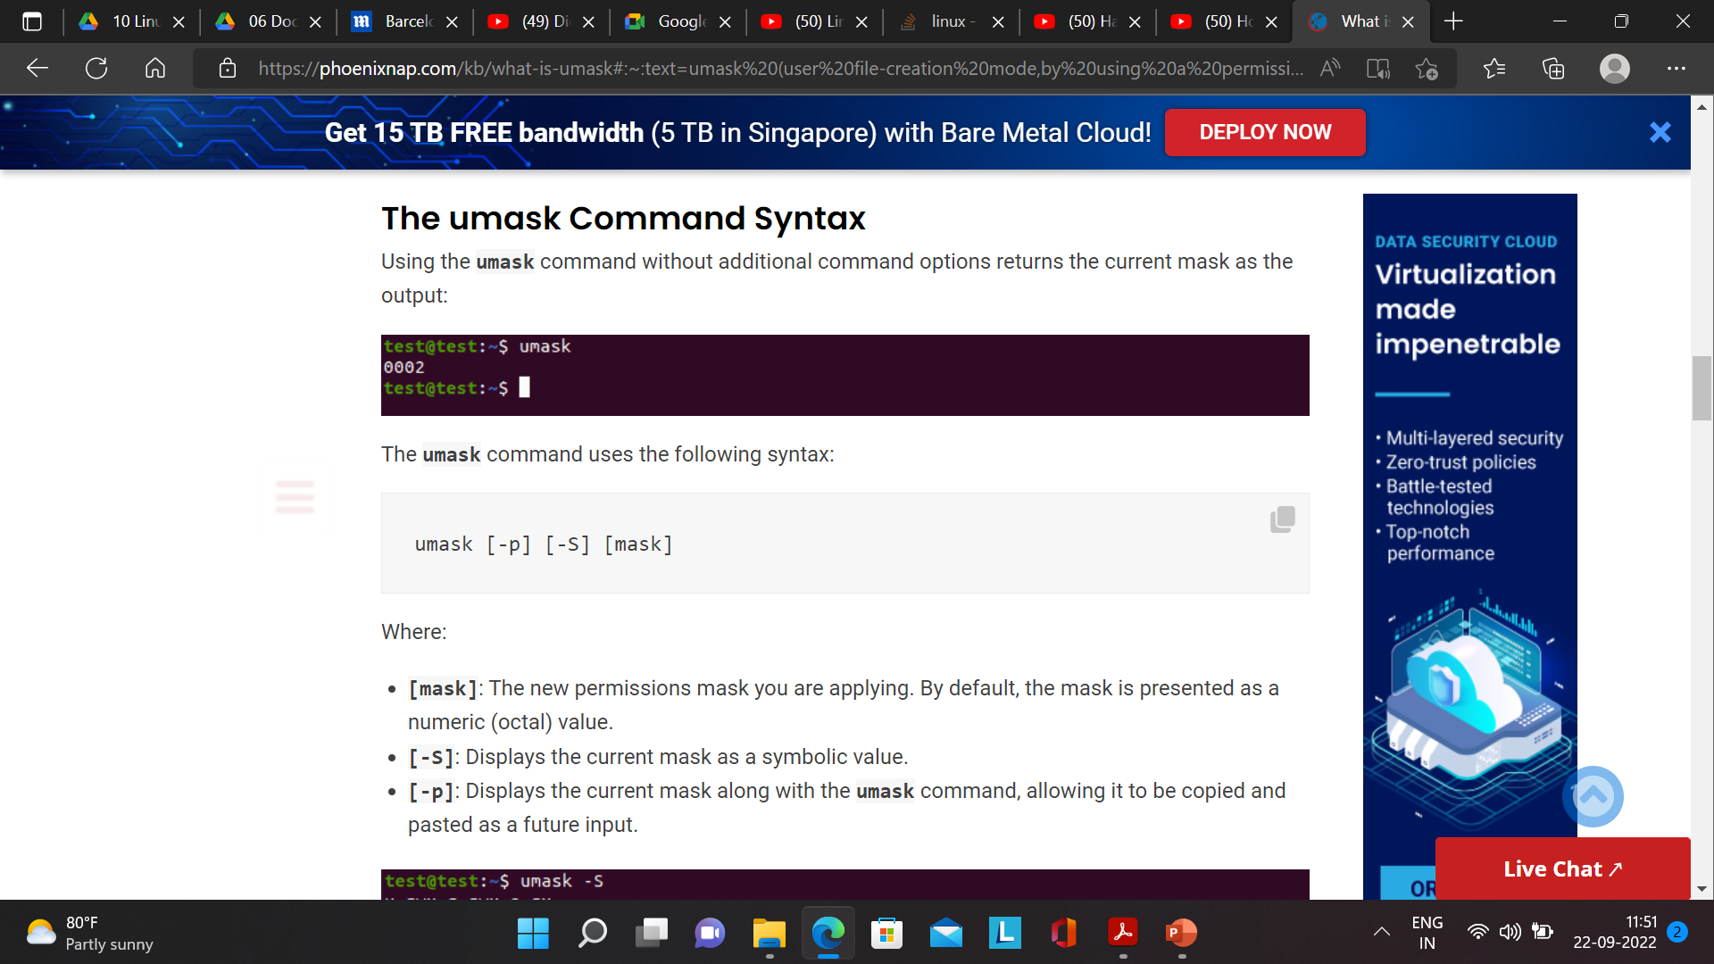

Slide 40
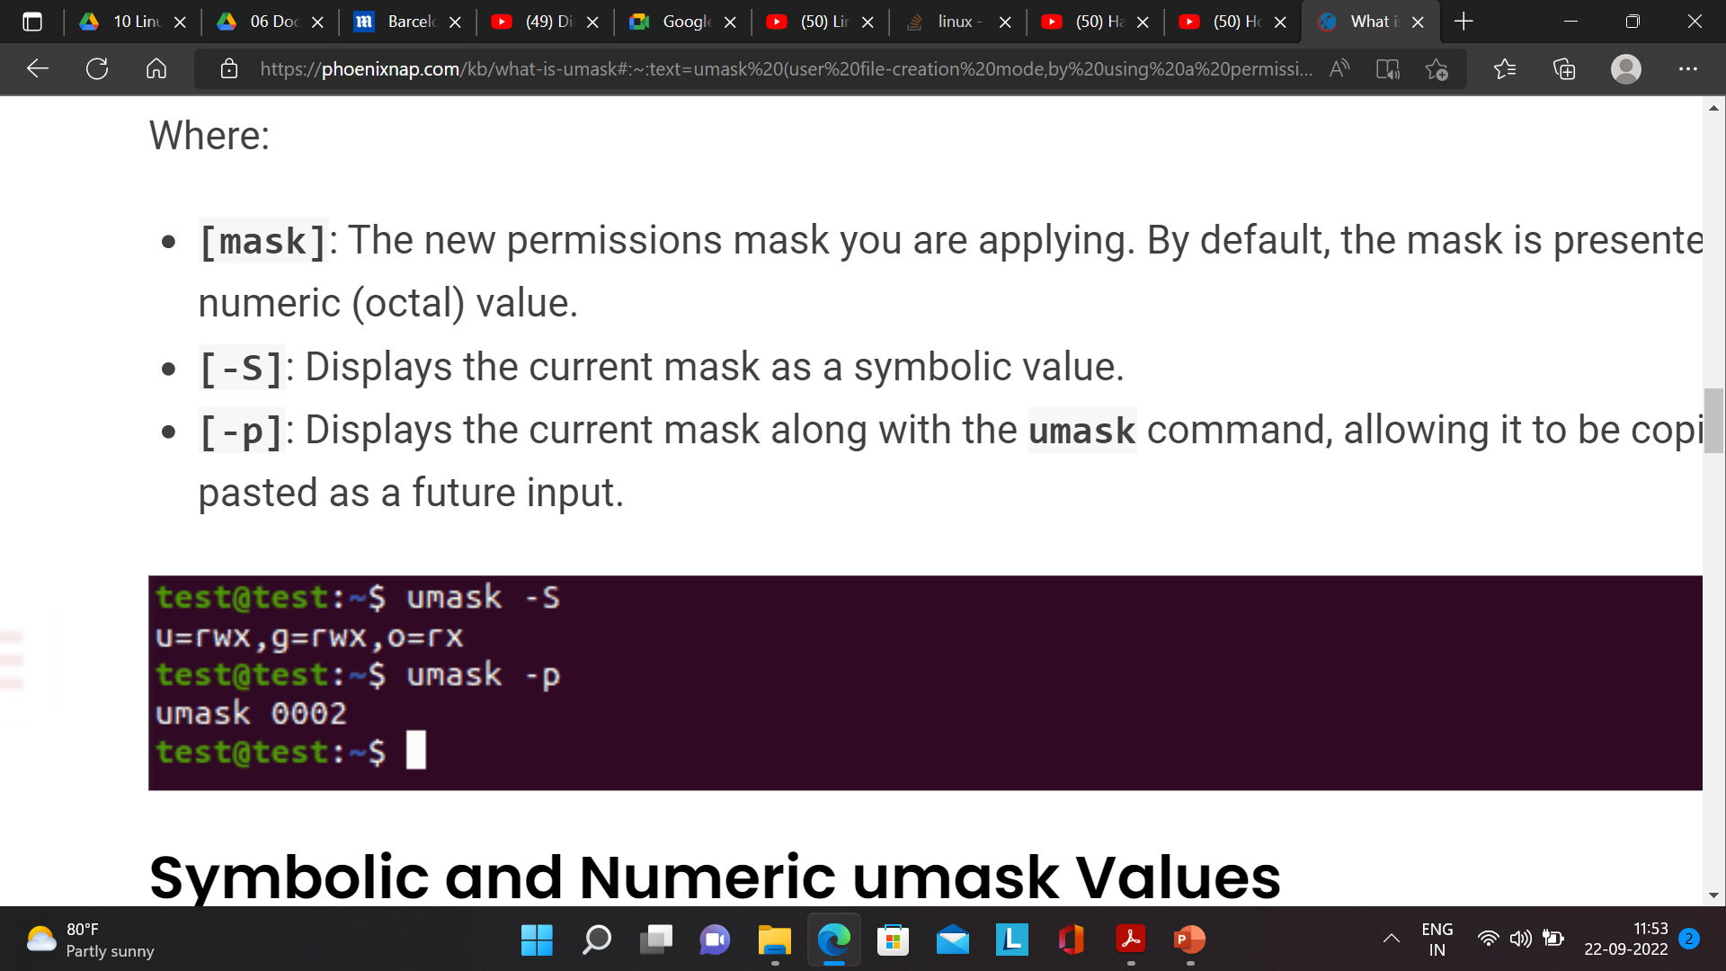
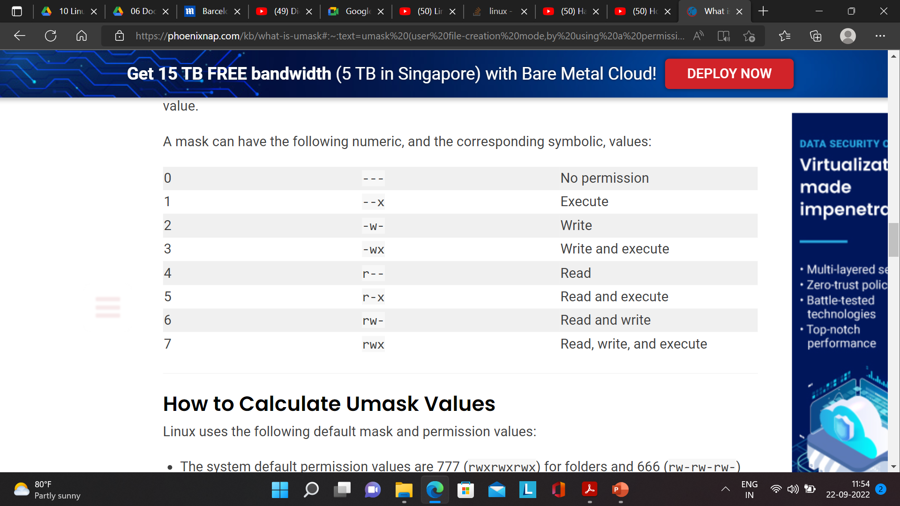

Slide 41
